Slide 1
CSE-3108 Spring, 2016 Interfacing with Dot Matrix Display through 8255

Slide 2
Tasks: Displaying and moving different shapes on the Dot Matrix display using 8086 microprocessor
Dot Matrix Display
There is a 8X8 Dot Matrix LED display(KMD D1288C) embedded on the MDA-8086 trainer toolkit
The Dot Matrix inside the MDA – 8086 trainer kit can be used to display any pattern of LEDs in the dot matrix display
This requires PIO-8255 ports which are already connected to the Dot Matrix internally. You don’t have to manually setup a connection between the Dot Matrix and 8255A
The 8255A used to interface the Dot Matrix with 8086 is different from the 8255A that was used to interface FND with 8086. Hence, MDA-8086 has multiple 8255A embedded in
By executing proper instructions, we can access these ports and provide binary or hex value to switch the required segment on and off.
In order to turn an LED ON, a logical 0 should be provided to the row and a logical 1 should be provided to the column because of the following arrangement
Each of the Dot Matrix LED can be lit in green, or red, or both(orange)

Slide 3
Introduction to 8255(From Last Slide)
The Intel 8255 Programmable Peripheral Interface (PPI) chip is a peripheral chip originally developed for the Intel 8085 microprocessor
8255 has 40 pins in total, for interfacing with other devices, power supply, chip select etc.
24 of these pins are intended towards I/O operations
These pins are divided intro three 8-bit ports[Port A, Port B, Port C]
Port A, Port B can be used as 8-bit I/O ports
Port C can either be used as a 8-bit I/O port, or two 4-bit I/O ports.
Port C can also be used for producing handshaking signals during handshake data transfer

Slide 4
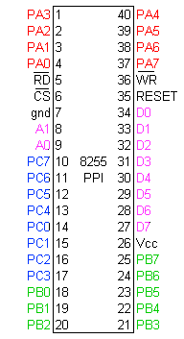
8255A ports

Slide 5
Introduction to 8255(From Last Slide)
The three ports are further grouped as follows-
Group A : Port A and upper part of Port C
Group B: Port B and lower part of Port C
8255 contains four registers. One for each of Port A, B, C; and another one called ‘Control Word Register’(CWR) for storing the current control state of 8255. CWR stores bits which denote information like whether Port A, Port B, Port C upper or Port C lower are in input mode or output mode.
Eight data lines (D0-D7) are available (with an 8-bit data buffer) to read/write data into the ports or control register
The address lines A1 and A0 allow to successively access any one of the ports or the control register
Port A, B, C are connected with external devices, and data lines(D0-D7) and address lines(A0, A1) are connected with the microprocessor

Slide 6
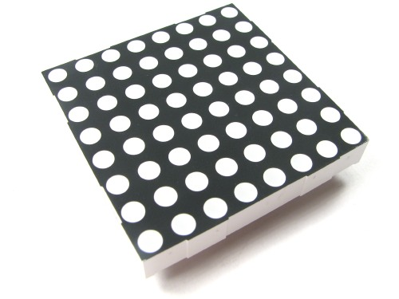
A 8X8 Dot Matrix Display

Slide 7
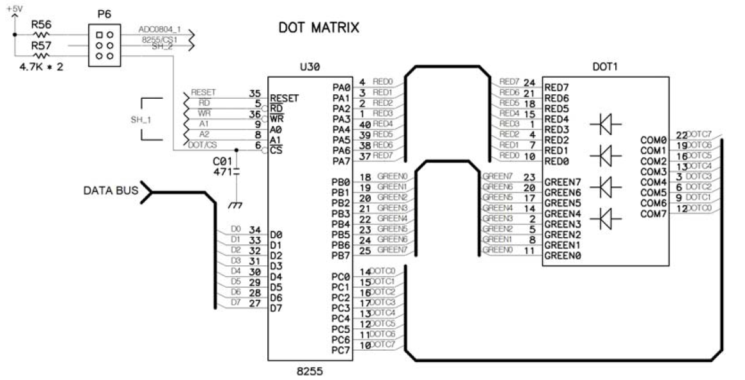
Fig: Dot Matrix LED Interface

Slide 8
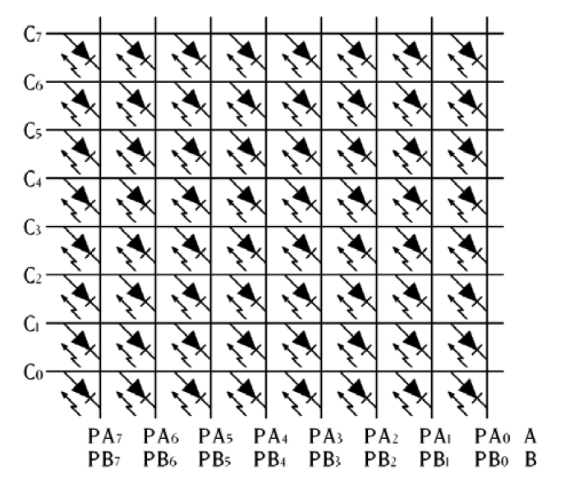
Dot Matrix Display internal wiring

Slide 9
How to display a shape on the Dot Matrix
The Dot Matrix display requires (3 * 8bits) input from 8225A ports. Check the interfacing diagram for clarifications
Port A denotes whether or not to display green lights along the rows
Port B denotes whether or not to display red lights along the rows
Port C denotes whether or not to display any light along the columns
Remember to throw P6 like this before watching an output on the Dot Matrix Display

Slide 10

How to display a shape on the Dot Matrix
Consider the bitmasks to be sent to different ports of 8255A-
Port A, Port B : For the bitmask sent to these ports, LSB denotes the lowest row, and MSB denotes the highest row of the Dot Matrix Display
Port C : For the bitmask sent to this port, LSB denotes the leftmost column, and MSB denotes the rightmost column of the Dot Matrix Display
Remember to throw P6 like this before displaying an output on the Dot Matrix Display

Slide 11
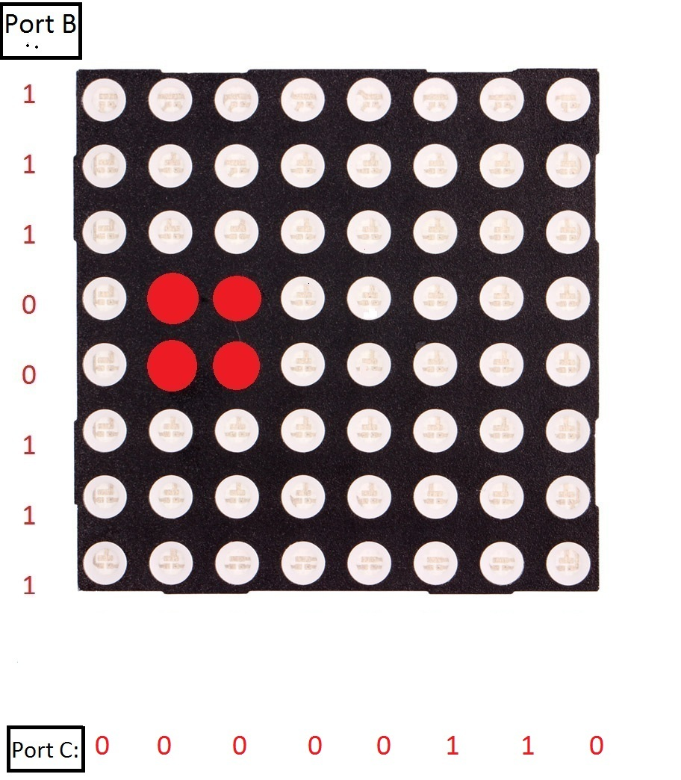
How to display a shape on the Dot Matrix (This was erroneous on the slide previously provided)
Let’s say we output PortA = 11111111 PortB = 11100111 PortC = 00000110 What will we see?

Slide 12
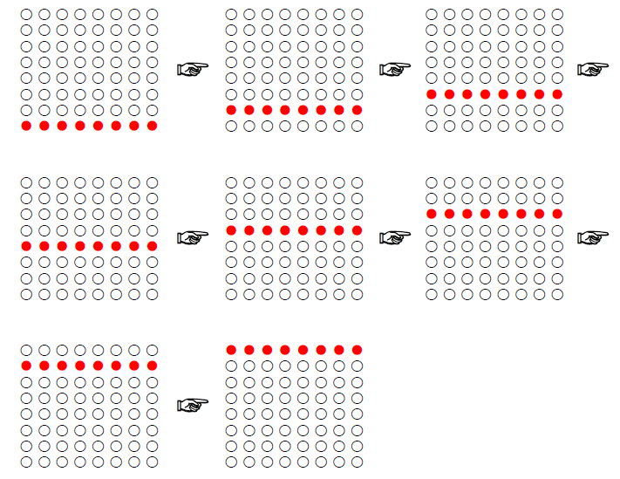
Task-1: Display a red horizontal bar that rotates from bottom to top

Slide 13
CODE SEGMENT
ASSUME CS:CODE,DS:CODE,ES:CODE,SS:CODE
PPIC_C EQU 1EH
PPIC EQU 1CH
PPIB EQU 1AH
PPIA EQU 18H
ORG 1000H
MOV AL, 10000000B
OUT PPIC_C, AL ; Take PortA, PortB, PortC to
; output modes
MOV AL, 11111111B
OUT PPIC, AL ; Since all columns should be
; lit at the same time
MOV AL, 11111111B
OUT PPIA, AL ; We'll never light up the
; green lights
; So, output 11111111 to turn
; off all green outputs
L1: MOV AL, 11111110B ; Since only one row to be
; lit at a time
MOV CX, 08H
L2: OUT PPIB, AL
CALL TIMER
STC
ROL AL, 1
LOOP L2
JMP L1
INT 3
; TIMER procedure
TIMER: PUSH CX
MOV CX, 8FFFH
TIMERLOOP: NOP
NOP
NOP
NOP
LOOP TIMERLOOP
POP CX
RET
;
CODE ENDS
END

Slide 14
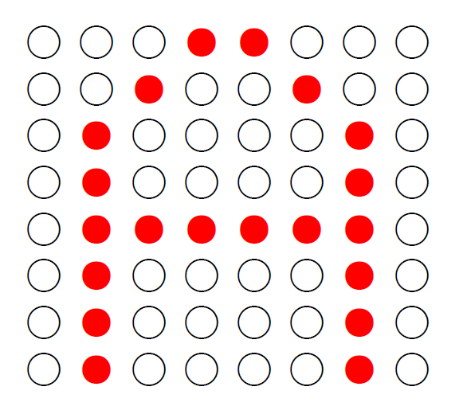
Task-2: Display the letter A

Slide 15
CODE SEGMENT
ASSUME CS:CODE,DS:CODE,ES:CODE,SS:CODE
PPIC_C EQU 1EH
PPIC EQU 1CH
PPIB EQU 1AH
PPIA EQU 18H
ORG 1000H
MOV AL, 10000000B
OUT PPIC_C, AL ; Port A, B, C to output mode
MOV AL, 11111111B
OUT PPIA, AL ; We'll never light up the green lights
L1: MOV AH, 00000001B
CALL DISPLAY_A
JMP L1
; Calling this procedure destroys AH
DISPLAY_A:
MOV SI, OFFSET FONT
MOV CX, 08H
DISPLOOP: MOV AL, BYTE PTR CS:[SI]
OUT PPIB, AL
MOV AL, AH
OUT PPIC, AL
CALL TIMER
INC SI
CLC
ROL AH, 1
LOOP DISPLOOP
RET
; TIMER procedure
TIMER: PUSH CX
MOV CX, 300
TIMER1: NOP
NOP
NOP
NOP
LOOP TIMER1
POP CX
RET
;
FONT: DB 11111111B; Mask for the column on the far left
DB 11000000B
DB 10110111B
DB 01110111B
DB 01110111B
DB 10110111B
DB 11000000B
DB 11111111B; Mask for the column on the far right
;
CODE ENDS
END

Slide 16
Task-2: Display the letter A, rotating from right to left

Slide 17
CODE SEGMENT
ASSUME CS:CODE,DS:CODE,ES:CODE,SS:CODE
PPIC_Control EQU 1EH
PPIC EQU 1CH
PPIB EQU 1AH
PPIA EQU 18H
ORG 1000H
MOV AL, 10000000B
OUT PPIC_Control, AL
MOV AL, 11111111B
OUT PPIA, AL
MOV BL, 1H
L1: MOV AH, BL
CALL MANY_TIMES_A
CLC
ROR BL, 1
JMP L1

Slide 18
; Displays the letter 'A' 50 times, so ensure that 'A' is displayed
; for a long time at a fixed position before rotating it to the left
; --------- Calling this procedure destroys AH, maintains CX
MANY_TIMES_A:
PUSH CX
MOV CX, 50 ; Show this letter 50 times
MTA_L: CALL DISPLAY_A
LOOP MTA_L
POP CX
RET
;
; Displays 'A' once at a position
; --------- Calling this procedure destroys AH, maintains CX
DISPLAY_A:
PUSH CX
MOV SI, OFFSET FONT
MOV CX, 08H
DISPLOOP: MOV AL, BYTE PTR CS:[SI]
OUT PPIB, AL
MOV AL, AH
OUT PPIC, AL
CALL TIMER
INC SI
CLC
ROL AH, 1
LOOP DISPLOOP
POP CX
RET
;

Slide 19
TIMER: PUSH CX
MOV CX, 300
TIMER1: NOP
NOP
NOP
NOP
LOOP TIMER1
POP CX
RET
;
FONT: DB 11111111B
DB 11000000B
DB 10110111B
DB 01110111B
DB 01110111B
DB 10110111B
DB 11000000B
DB 11111111B
;
CODE ENDS
END

